Slide 1

Chapter 6: Basic SQL

Slide 2
6.1 – SQL Data Definition and Data Types
6.2 – Specifying Constraints in SQL
6.3 – Basic Retrieval Queries in SQL
6.4 – INSERT, DELETE, and UPDATE Statements in SQL
6.5 – Additional Features of SQL

Slide 3
6.1 – SQL Data Definition and Data Types

Slide 4
Basic SQL
SQL (Structured Query Language)
Considered one of the major reasons for the commercial success of relational databases
Appeared 1974
Last stable release SQL:2011
Core specification - Standards
ANSI (since 1986)
ISO/IEC 9075 (since 1987)

Slide 5
Basic SQL
Statements for data definitions, queries, and updates
DDL, DML, and VDL
Plus specialized extensions (which may be implementation specific)
Notes:
e.g. MySQL does not support RIGHT JOIN

Slide 6
Basic SQL
SQL language is case insensitive
keywords
namespaces
SQL data values are case sensitive
For readability, some case style conventions may be used
Each statement in SQL ends with a semicolon

Slide 7
Schema and Catalog Concepts in SQL
SQL schema (In most systems, a Database)
Identified by a schema name
Includes an authorization identifier and descriptors for each element
e.g. CREATE SCHEMA COMPANY AUTHORIZATION ‘Jsmith’;
Schema elements include
Tables
Constraints
Views
Domains
and other constructs

Slide 8
SQL Terminology
Terminology:
Table, row, and column used for relational model terms relation, tuple, and attribute
CREATE statement
Main SQL command for data definition

Slide 9
The CREATE TABLE Command in SQL
Specify a new relation (table)
Provide name
Specify attributes and initial constraints
Can optionally specify schema:
CREATE TABLE COMPANY.EMPLOYEE ...
or
CREATE TABLE EMPLOYEE ...
Notes:
use company;

Slide 10
The CREATE TABLE Command in SQL
Base tables (base relations)
Relation and its tuples are actually created and stored as a file by the DBMS
Virtual relations
Created through the CREATE VIEW statement
Notes:
Views behave as tables in most SQL
• SHOW TABLES;
DROP TABLE view_name # does not work

Slide 11
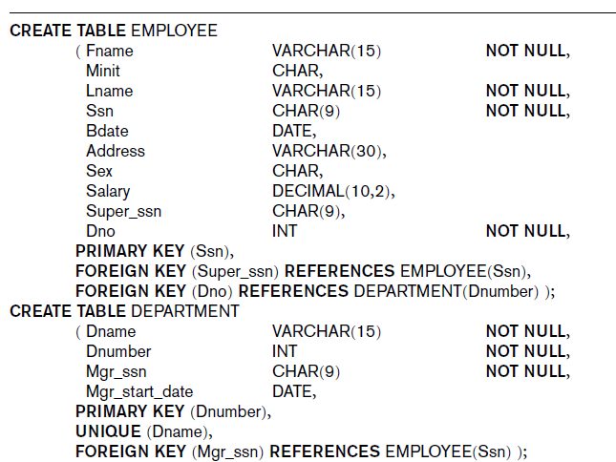
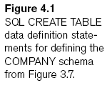
CREATE TABLES for Company Data
Notes:
Don’t spend too much time on this slide.
Details and provided script to come later
Slide 14 asks some questions about slide 12-13

Slide 12
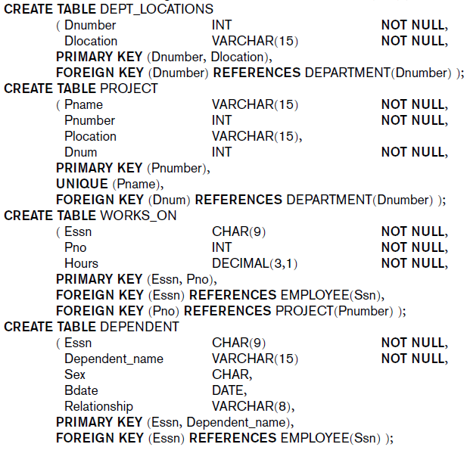
CREATE TABLES for Company Data

Slide 13
CREATE TABLE Command
Does the order of table creation matter?
Some foreign keys may cause errors
Specified either via:
Circular references
Or because they refer to a table that has not yet been created

Slide 14
Attribute Data Types and Domains in SQL
Different dialects of SQL may have different types
Microsoft SQL Server
Oracle 11g, 10g, XE, etc.
MySQL
IBM DB2
PostgreSQL
SQLite

Slide 15
Attribute Data Types and Domains in SQL
Basic data types
Numeric data types
Integer numbers: INTEGER, INT, and SMALLINT
Floating-point (real) numbers: FLOAT or REAL, and DOUBLE PRECISION
Character-string data types
Fixed length: CHAR(n), CHARACTER(n)
Varying length: VARCHAR(n), CHAR VARYING(n), CHARACTER VARYING(n)

Slide 16
Attribute Data Types and Domains in SQL
Bit-string data types
Fixed length: BIT(n)
Varying length: BIT VARYING(n)
Boolean data type
Values of TRUE or FALSE or NULL
DATE data type (Use DateTime instead)
Ten positions
Components are YEAR, MONTH, and DAY in the form YYYY-MM-DD

Slide 17
Attribute Data Types and Domains in SQL
Custom Domain
Name used with the attribute specification
Makes it easier to change the data type for a domain that is used by numerous attributes
Improves schema readability
Example:
CREATE DOMAIN SSN_TYPE AS CHAR(9);

Slide 18
6.2 – Specifying Constraints in SQL
Notes:
Start 001 Feb 3, 2015

Slide 19
Specifying Constraints in SQL
Basic constraints:
Key and referential integrity constraints
Restrictions on attribute domains and NULLs
Constraints on individual tuples within a relation

Slide 20
Giving Names to Constraints
Keyword CONSTRAINT
Explicitly name a constraint
Useful for later altering
E.g.: Alter Table Department
Drop constraint DEPTSK;

Slide 21
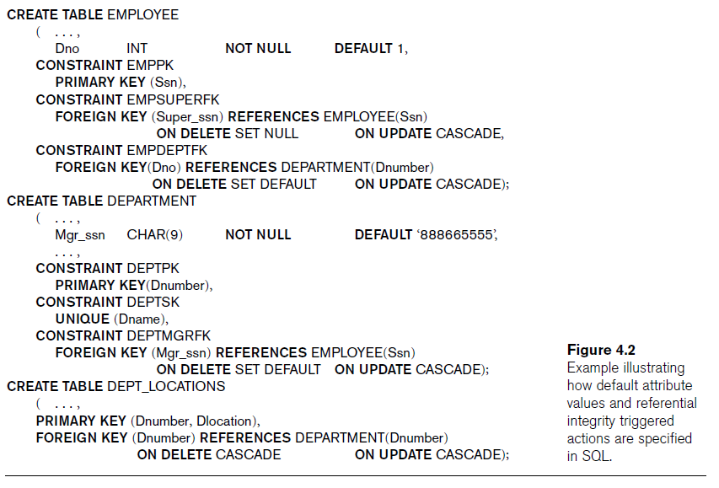
Specifying Attribute Constraints and Not Null and Default value
NOT NULL
NULL is not permitted for a particular attribute
Default value
DEFAULT <value>

Slide 22
Specifying Attribute Constraints and Check clause
CHECK clause
Dnumber INT NOT NULL
CHECK (Dnumber > 0 AND Dnumber < 21),
CREATE TABLE Persons ( ID int NOT NULL, LastName varchar(255) NOT NULL, FirstName varchar(255), Age int CHECK (Age>=18) );

Slide 23
Specifying Constraints on Tuples Using CHECK
CHECK clauses at the end of a CREATE TABLE statement
Apply to each tuple individually
CHECK (Dept_create_date <= Mgr_start_date);

Slide 24
Another Example
CHECK clauses at the end of a CREATE TABLE statement
CREATE TABLE Persons ( ID int NOT NULL, LastName varchar(255) NOT NULL, FirstName varchar(255), Age int, City varchar(255), CONSTRAINT CHK_Person CHECK (Age>=18 AND City='Sandnes') );
Is the Above constraint equivalent to the following two constraints?
CONSTRAINT CHK_Age CHECK (Age>=18),
CONSTRAINT CHK_City CHECK (City='Sandnes’)

Slide 25
Specifying Key Integrity Constraints
PRIMARY KEY clause
Specifies one or more attributes that make up the primary key of a relation
Dnumber INT PRIMARY KEY,
Or
Dnumber INT not null,
….
Primary Key(Dnumber),
UNIQUE clause
Specifies alternate (secondary) keys
Dname VARCHAR(15) UNIQUE;

Slide 26
Specifying Key and Referential Integrity Constraints
FOREIGN KEY clause
Default operation: reject update on violation
Attach referential triggered action clause
Options include SET NULL, CASCADE, and SET DEFAULT
Action taken by the DBMS for SET NULL or SET DEFAULT is the same for both ON DELETE and ON UPDATE
CASCADE option suitable for “relationship” relations

Slide 27
6.3 – Basic Retrieval Queries in SQL

Slide 28
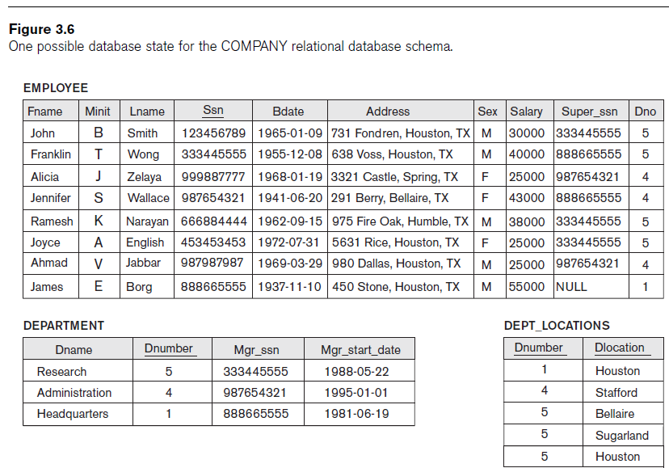
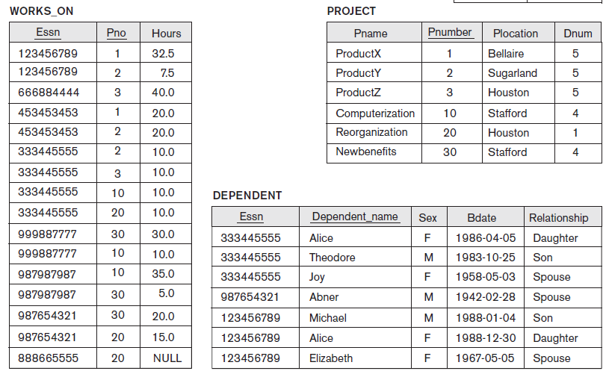
Notes:
Continued on next page

Slide 29
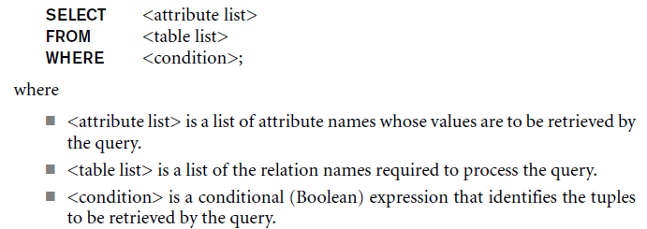
Basic Retrieval Queries in SQL
SELECT statement
One basic statement for retrieving information from a database
Basic form of the SELECT statement:

Slide 30
Projection attributes
SELECT
Attributes whose values are to be retrieved
Selection condition
WHERE
Boolean condition that must be true for any retrieved tuple
Logical comparison operators
=, <, <=, >, >=, and <>

Slide 31
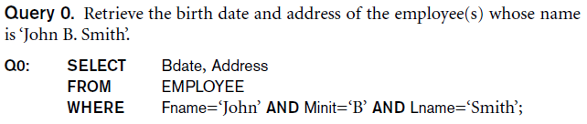
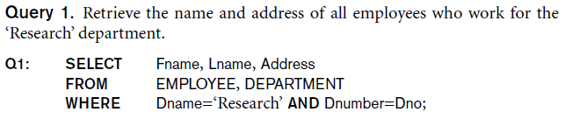
Some Queries

Slide 32
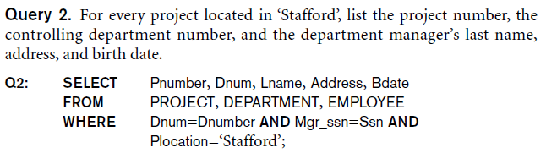
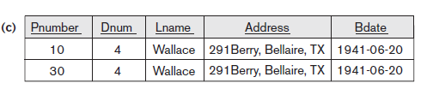
Some Queries

Slide 33
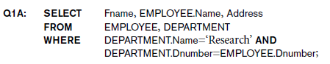
Ambiguous Attribute Names
Same name can be used for two (or more) attributes
As long as the attributes are in different relations
Must qualify the attribute name with the relation name to prevent ambiguity

Slide 34
Aliasing, Renaming, and Tuple Variables
The SQL AS keyword
Attribute or Table Aliases
SELECT CustomerID AS ID, CustomerName AS Customer FROM Customers;
Examples
SELECT attribute AS attr_alias_name
FROM table_name AS table_alias_name
FROM (subquery) AS virtual_table_name
CAVEAT
SQL syntax allows AS to be implied
A missing comma in a SELECT clause can be parsed as an implied AS
SELECT CustomerID ID, CustomerName Customer FROM Customers;
Notes:
AS is optional, but helpful when a function is used in the SELECT clause
AS is NOT optional in a virtual table
Remove this?
EMPLOYEE AS E(Fn, Mi, Ln, Ssn, Bd, Addr, Sex, Sal, Ssn, Dno)

Slide 35
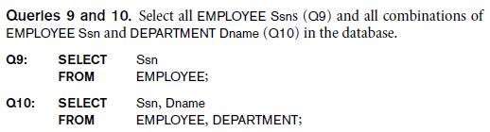
Unspecified WHERE Clause and Use of the Asterisk
Missing WHERE clause
Indicates no condition on tuple selection
CROSS PRODUCT
All possible tuple combinations

Slide 36
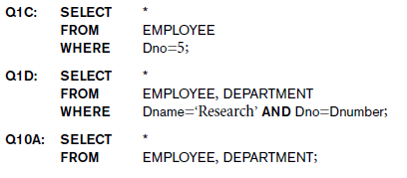
Unspecified WHERE Clause and Use of the Asterisk
Specify an asterisk (*)
Retrieve all the attribute values of the selected tuples

Slide 37
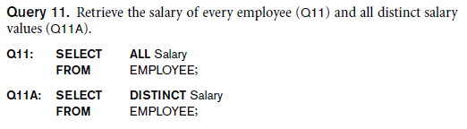
Tables as Sets in SQL
SQL does not automatically eliminate duplicate tuples in query results
Use the keyword DISTINCT in the SELECT clause
Only distinct tuples should remain in the result

Slide 38
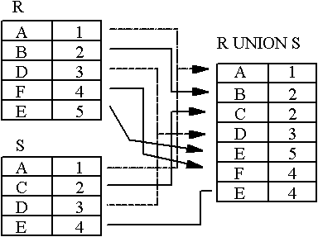
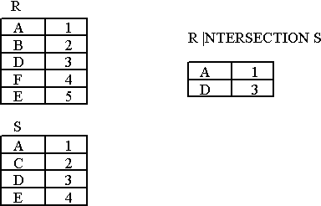
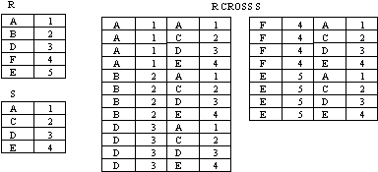
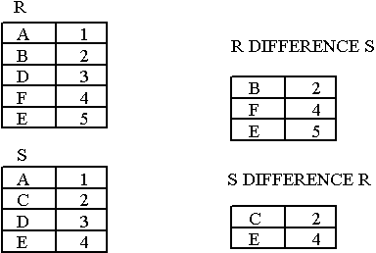
Cartesian Product, UNION, INTERSECTION, and MINUS
Union, Intersection, Set Difference, Cartesian Product

Slide 39
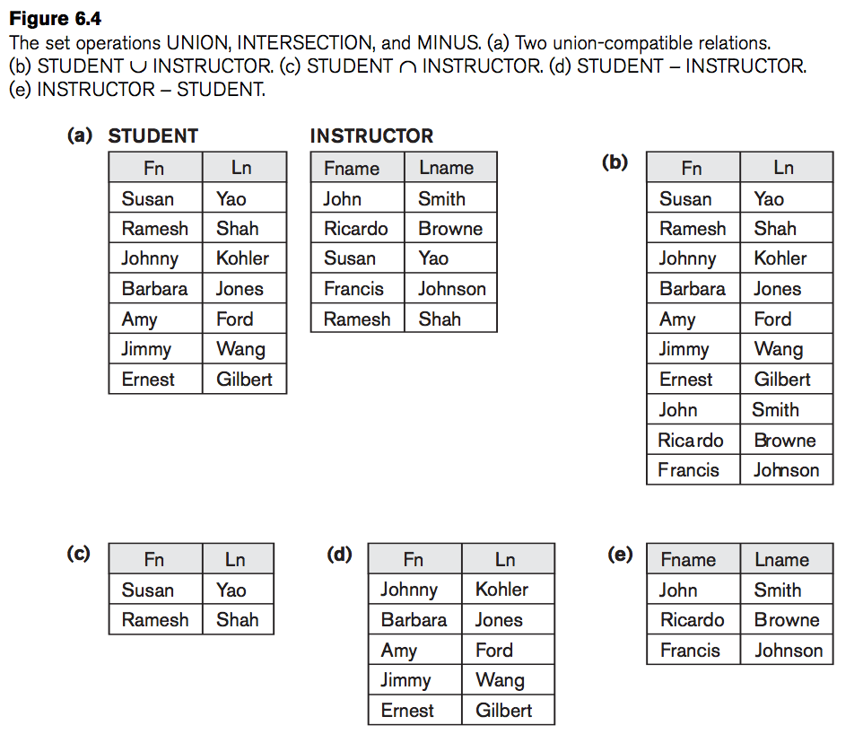
UNION, INTERSECTION, and MINUS

Slide 40
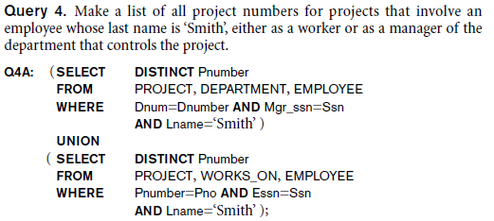
Tables as Sets in SQL
Set operations
UNION, INTERSECT, EXCEPT (Set difference)
Corresponding multiset operations: UNION ALL, EXCEPT ALL, INTERSECT ALL
The only difference between Union and Union All is that Union extracts the rows that are being specified in the query while Union All extracts all the rows including the duplicates (repeated values) from both the queries.
Notes:
#RESUME both Feb 16, 2016

Slide 41
Substring Pattern Matching and Arithmetic Operators
LIKE comparison operator
Used for string pattern matching
% replaces an arbitrary number of zero or more characters
underscore (_) replaces a single character

Slide 42
Substring Pattern Matching and Arithmetic Operators
Standard arithmetic operators:
Addition (+), subtraction (-), multiplication (*), and division (/)
BETWEEN comparison operator
SELECT 150%7;

Slide 43
Ordering of Query Results
SQL results are inherently not ordered. To change this, use ORDER BY clause
Keyword DESC to see result in a descending order of values
Keyword ASC to specify ascending order explicitly

Slide 44
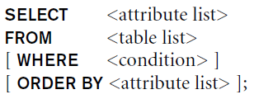
Discussion and Summary of Basic SQL Retrieval Queries

Slide 45
6.4 – INSERT, DELETE, and UPDATE
Statements in SQL

Slide 46
Modifying the Database Data
Three commands used to modify the database:
INSERT
DELETE
UPDATE

Slide 47
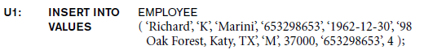
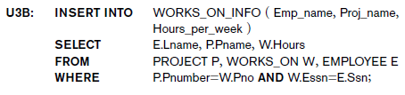
The INSERT Command
Specify the relation name and a list of values for the tuple

Slide 48
The INSERT Command
Specify the relation name and a list of values for the tuple

Slide 49
The CREATE TABLE Command
Define auto-increment at table create time
Define/Add auto-increment to an existing table
AUTO_INCREMENT column begins at 1
CREATE TABLE Persons (
ID int NOT NULL AUTO_INCREMENT PRIMARY KEY,
LastName VARCHAR(255) NOT NULL,
FirstName VARCHAR(255),
Address VARCHAR(255),
City VARCHAR(255)
);
ALTER TABLE Persons AUTO_INCREMENT=100

Slide 50
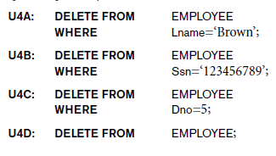
The DELETE Command
Removes tuples from a relation
Includes a WHERE clause to select the tuples to be deleted

Slide 51
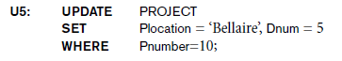
The UPDATE Command
Modify attribute values of one or more selected tuples
Additional SET clause in the UPDATE command
Specifies attributes to be modified and new values

Slide 52
Additional Features of SQL
Techniques for specifying complex retrieval queries
Writing programs in various programming languages that include SQL statements
Set of commands for specifying physical database design parameters, file structures for relations, and access paths
Transaction control commands

Slide 53
Additional Features of SQL
Specifying the granting and revoking of privileges to users
Constructs for creating triggers
Enhanced relational systems known as object-relational
New technologies such as XML and OLAP

Slide 54
Summary
SQL
Comprehensive language
Data definition, queries, updates, constraint specification, and view definition
Covered in Chapter 6:
Data definition commands for creating tables
Commands for constraint specification
Simple retrieval queries
Database modification commands

